Slide 1
Deploy Spring Boot and Angular into ECS
Sona E S
Sowjanya Morisetty

Slide 2
Amazon ECS
Amazon Elastic Container Service (Amazon ECS) is a fully managed container orchestration service that simplifies your deployment, management, and scaling of containerized applications.
Amazon ECS will launch, monitor, and scale your application across flexible compute options with automatic integrations to other supporting AWS services that your application needs.
Perform system operations such as creating custom scaling and capacity rules , observe and query data from application logs and telemetry.

Slide 3
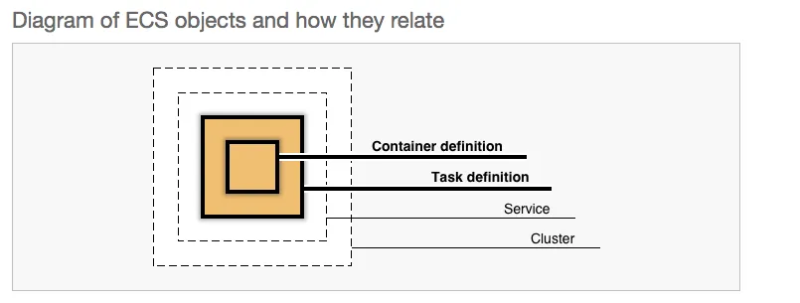
Amazon ECS

Slide 4
ECS consists of a few components::
Elastic Container Repository (ECR): A Docker repository to store your Docker images (similar as DockerHub but now provisioned by AWS).
Task Definition: A versioned template of a task which you would like to run. Here you will specify the Docker image to be used, memory, CPU, etc. for your container.
ECS Cluster: The Cluster definition itself where you will specify how many instances you would like to have and how it should scale.
Service: Based on a Task Definition, you will deploy the container by means of a Service into your Cluster.

Slide 5
Advantages
Scalability: Amazon ECS provides auto-scaling capabilities, allowing you to easily scale your application based on demand.
High availability: Amazon ECS supports running multiple tasks across multiple Availability Zones, ensuring high availability and fault tolerance.
Infrastructure management: ECS takes care of provisioning and managing the compute resources, allowing you to focus on your application development.
Integration with other AWS services: Amazon ECS seamlessly integrates with other AWS services like Elastic Load Balancing (ELB), AWS Identity and Access Management (IAM), AWS CloudFormation, and more. .

Slide 6
Disadvantages
Complexity: Setting up and configuring Amazon ECS can be complex, especially if you are new to containerization and infrastructure management.
Learning curve: Using Amazon ECS effectively requires learning and understanding the ECS-specific concepts, such as Task Definitions, Clusters, Services, and Load Balancers. This learning curve can be steep for beginners.
Operational overhead: While Amazon ECS abstracts away some of the infrastructure management, there is still some operational overhead involved in maintaining and monitoring the ECS cluster, including tasks, instances, and load balancing.
Cost: Although Amazon ECS offers a flexible pricing model, the cost can increase as your application scales and you provision more resources.

Slide 7
General steps to deploy.
Build the Angular application
Containerize the Spring backend
Build the Docker image
Push the Docker image to a container registry
Create an ECS Task Definition
Create an ECS Cluster
Configure an ECS Service
Set up an Application Load Balancer (ALB)
Test the deployment:

Slide 8
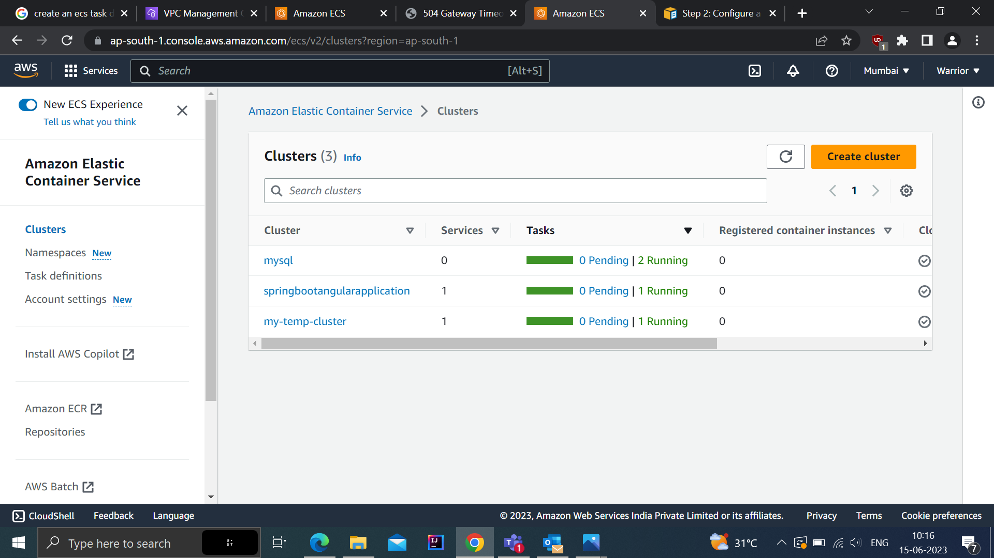
ECS CLUSTER

Slide 9
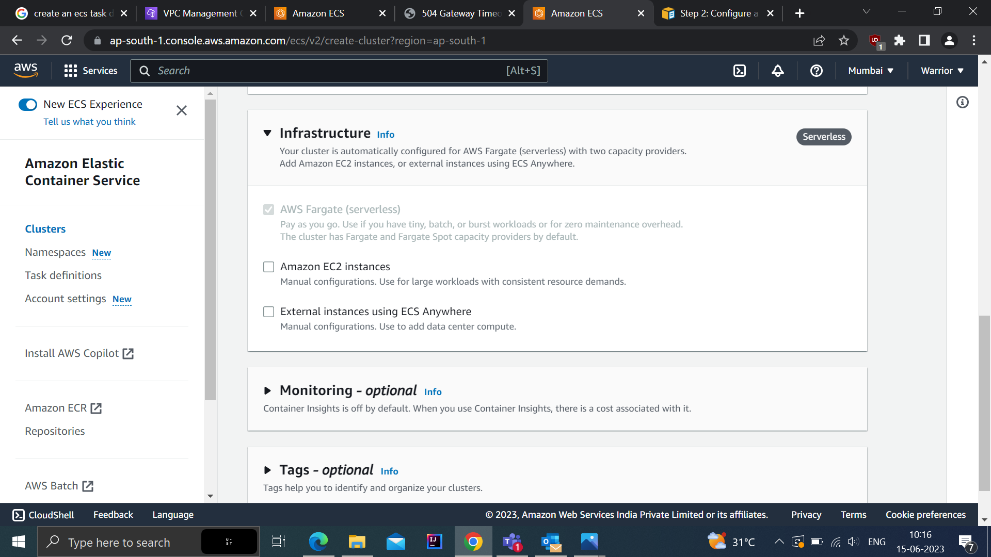
AWS FARGATE

Slide 10
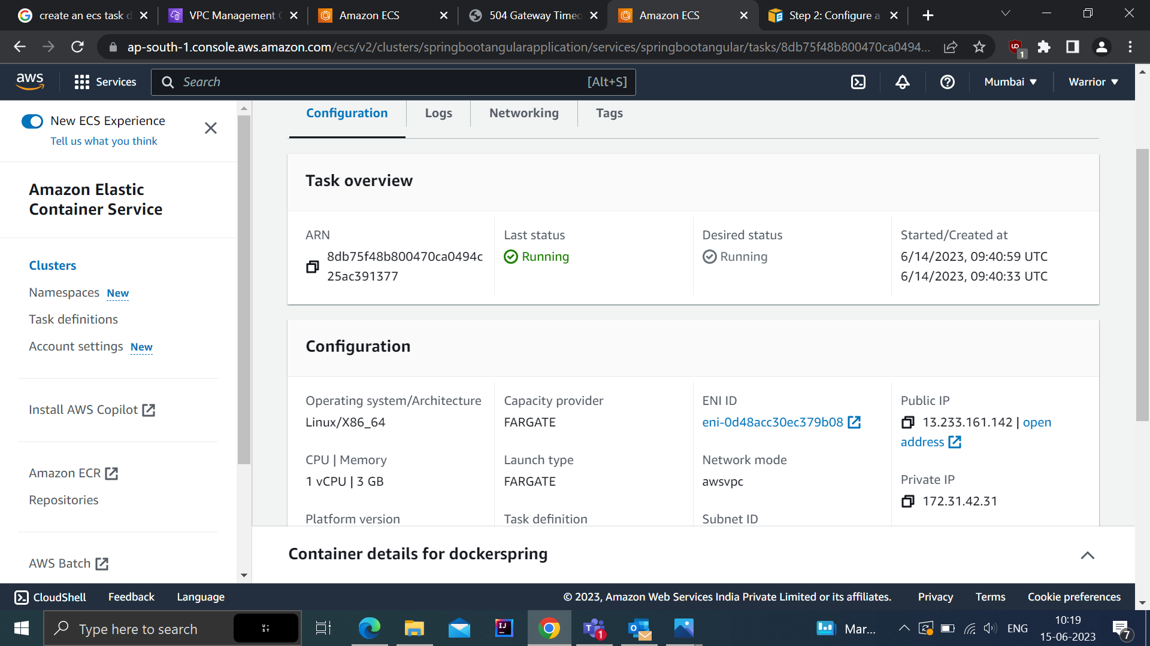
Deployed in AWS and get the IP Address

Slide 11
References
https://medium.com/bb-tutorials-and-thoughts/aws-deploying-angular-app-with-java-on-ecs-1dd72accbd56
https://youtu.be/zJMqCjc2qIc

